Slide 1



BRAKE FAILURE INDICATOR
Abhimanyu Iyer (1NH18EE700)
Dhanush L(1NH18EE716)
Niranjan C(1NH18EE731)
Prajwal A Raikar(1NH18EE734)
Mini Project Subject Code – 20EEL59
Date of Presentation: 25 .01.2021
Guided By
Prof.Sunil SK
Department of Electrical & Electronics Engineering
Bengaluru 560103, Karnataka, India

Slide 2
Overview
Objective
Literature Survey
Overview of the Proposed Work
Proposed Work Contribution
Results and Discussions
Conclusion & Future Scope
References
1

Slide 3
Objective
The main objective of our project is to avoid as many accidents as possible.
To save as many lives as possible.
All small number of accidents which includes trains and boats can be avoided.
To indicate the failure of the braking system.
This mechanism involves a Brake wire which runs from the brake lever to the braking mechanism set-up of the vehicle. It is this wire that gets pulled when we apply brakes to stop our vehicle
2

Slide 4
Literature Survey
Table.1
Sl.No | Detail of the Papers | Methodology | Outcome
1. | Brake failure indicator – IJERT(Volume 7, Issue 10) Paper ID-IJERTCONV7IS10069 | An 555 timer IC and BC557 PNP transistor is used to build the circuit | The transistor works on monitoring the brake wire and helps in deciding which led to glow.
2. | International Journal of Innovative Technology and Exploring Engineering (IJITEE) ISSN: 2278-3075, Volume-9 Issue-2, December 2019 | The main components of EBS are the NE555 timer and the BC557 transistor followed by braking mechanism to wheel. | When the brake wire is damaged the transistor will be in off condition,then the green led will be turned off.which in turn activates the red led and the buzzer will be connected to the ground.the timer used will be in astable condition.this gives the blinking of led or the beep sound.
3. | IEEE Transaction on industrial Electronics ( Volume: 62, Issue: 10, Oct. 2015) | An 555 timer IC and BC557 PNP transistor is used to build the circuit | The transistor works on monitoring the brake wire and helps in deciding which led to glow.
3

Slide 5
Problem Statement
Though the world is getting modernized, we have to face so many problems. One of such problems is accidents. One of the thing that everyone tried to avoid is while traveling is accidents, and sometimes it is inevitable. Now- a-days we can see accidents in every nook and corner of the world. It results in the death of thousands of lives. With the population ever climbing there are more vehicles than ever on road , which means there is a higher livelihood of the brakes giving out.
Methodology
We have used two main components i.e. 555timer and BC557 pnp transistor.
We have used two led's, red and green to indicate whether the brake is working or not.
We used a buzzer, in fact when the brake is failed there will be both audio and visual indication.
4

Slide 6
Block Diagram
Brake wire
555 timer
Green light
BC557 Transistor
Battery
Red light and buzzer
5

Slide 7
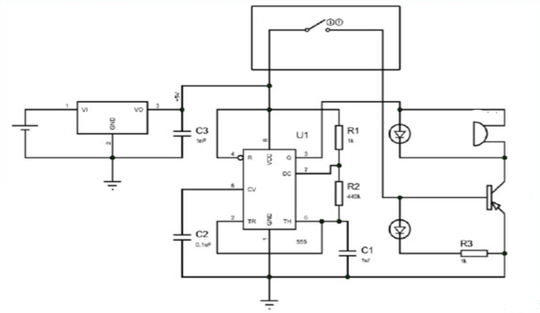
Technical Specification / Design/ Mathematical analysis Etc.
Brake wire
Battery
Green led
Buzzer
555 timer IC
BC557 PNP transistor
Red led
6

Slide 8
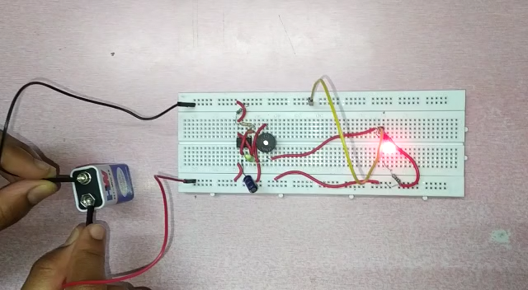
Results and Discussions
7

Slide 9
Conclusion
Brake failure indicator is a early warning system. It constantly monitors the condition of the brake and give audio visual indication.
Future Scope
For avoiding accidents due to brake failure, this circuit is designed, There is certain time factors which is used by the brake for it to stop when the brake is applied One can understand the brake malfunction if they re able to formulate the time and space needed by the brakes The maintenance of brake is very important and a lot of people take it for granted due to which the accidents occur.
This equipment is very useful as it has easy application since it is automatic and runs immediately causing and alarm. This indicates brake failure and the driver will ought to control the vehicle as soon as possible by avoiding more accidents.
Many lives at risks can be saved using this equipment and hence will have a brighter scope in future with more advanced technologies
8

Slide 10
REFERENCES
● https://circuitdigest.com/microcontroller-projects/brake-failure-indicator
● https://www.ijert.org/brake-failure-indicator-2 - INTERNATIONAL JOURNAL OF ENGINEERING RESEARCH & TECHNOLOGY
● https://www.ijltet.org/journal/ International Journal of Latest Trends in Engineering and Technology
● https://www.researchgate.net/publication/338037207_Design _A_Brake_Failure_Indicator
● https://www.engineersgarage.com/contributions/brake-failure-indicator/
A book on automobile engineering by kripal singh
● https://pdf.sciencedirectassets.com/
9

Slide 11


